Slide 1
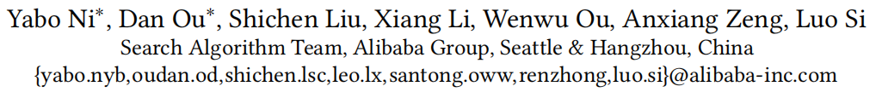
Perceive Your Users in Depth: Learning Universal User Representations from Multiple E-commerce Tasks

Slide 2
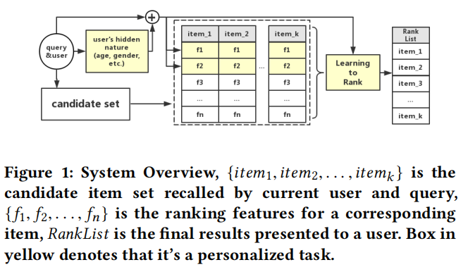
Overall Structure Of The Retrieval System

Slide 3
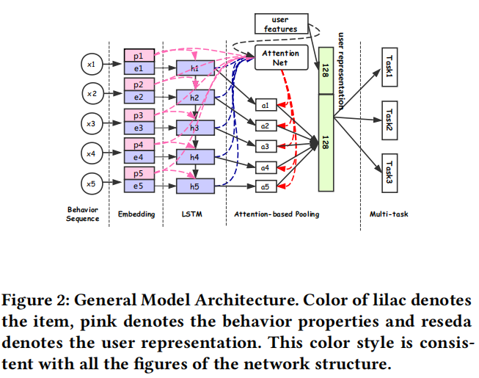
Model Architecture

Slide 4
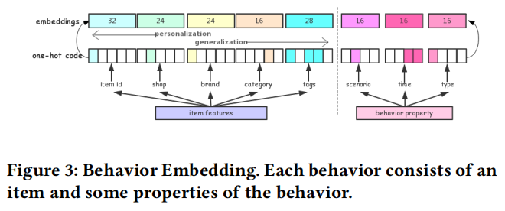

Slide 5
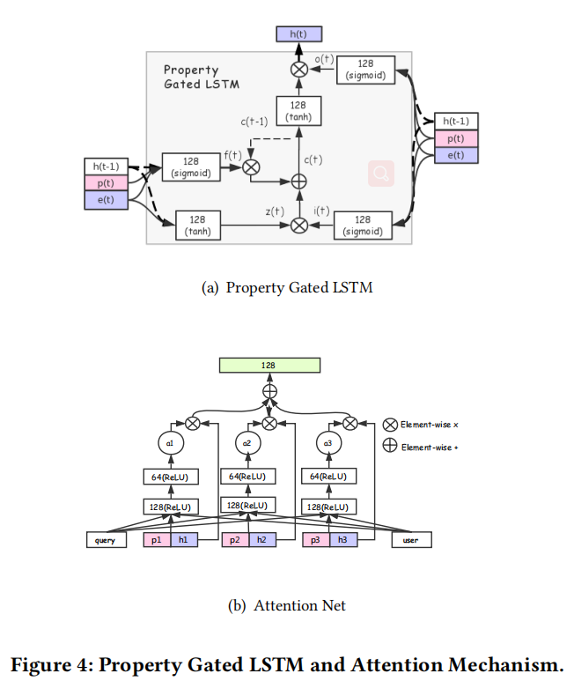
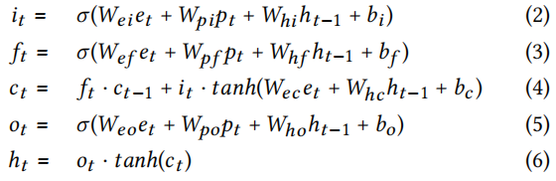
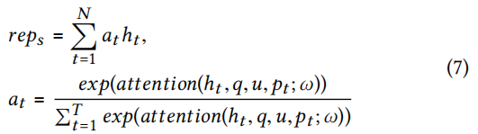

Slide 6
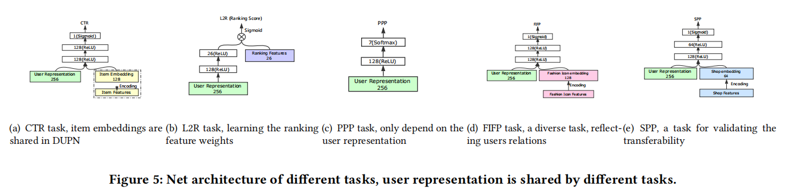
Click Through Rate Prediction(CTR)
Learning to Rank(L2R)
Price Preference Prediction(PPP)
Fashion Icon Following Prediction(FIFP)
Shop Preference Prediction (SPP)

Slide 7
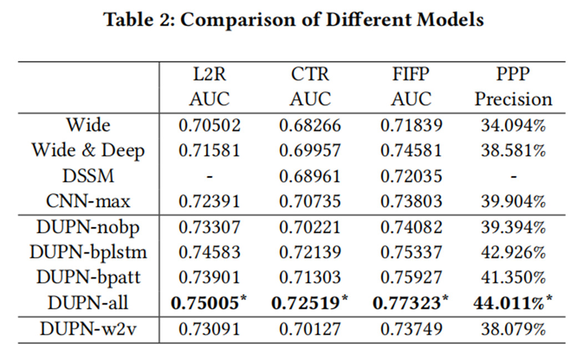
Experiment And Analysis

Slide 8
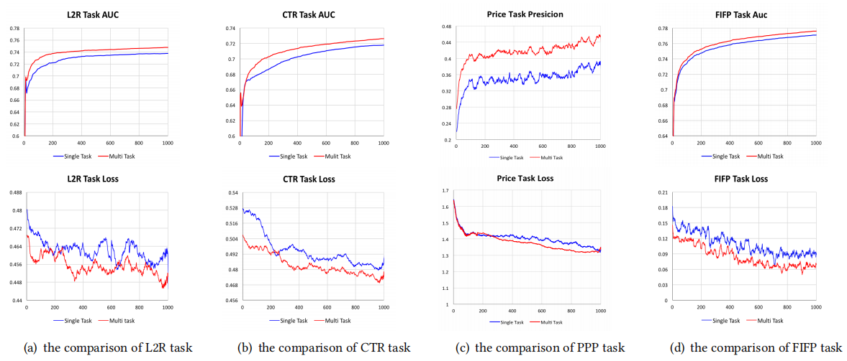

Slide 9
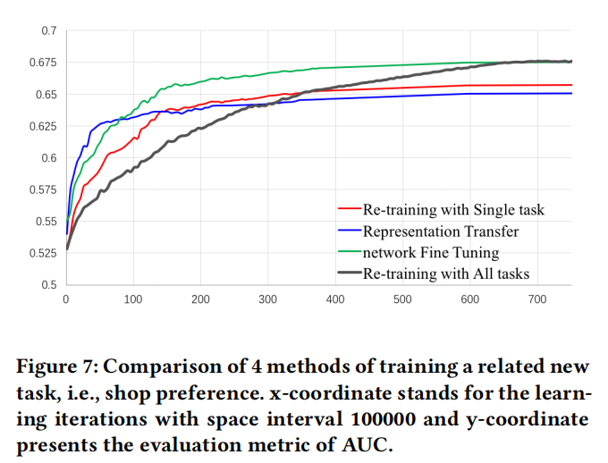

Slide 10
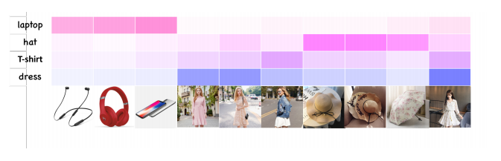
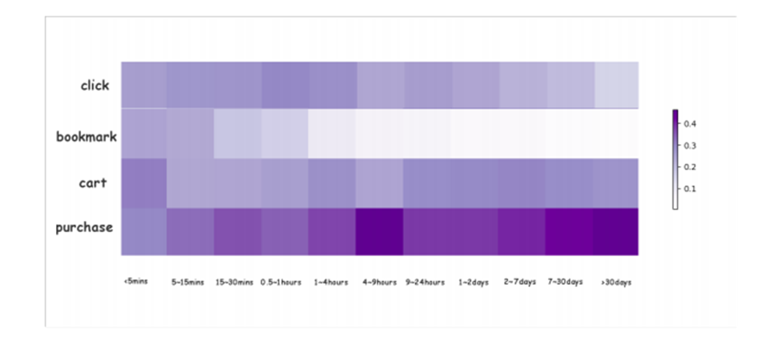
Examples of attention weights with different queries to a specific user behavior sequence. The higher attention weights of the item, the darker color of the grid.
Heat map of attention weights with different behavior types of different time.

Slide 11
